Slide 1

Welcome to the PHP OOP Course with Web Coding
Intro to PHP OOP and Important Definitions

Slide 2
What is Object-Oriented Programming(OOP)?
Object-Oriented Programming (OOP) is a programming paradigm that organizes code into objects—self-contained units that bundle data (properties) and behavior (methods).

Slide 3
Why Use OOP in PHP?
1-Better Code Organization
>>Group related data and functions together inside classes.
>>Easier to understand and maintain.
2. Reusability (DRY Principle)
>>Write once, reuse many times.
>>You can create general-purpose classes (e.g., a User class) and reuse them across your project
3. Scalability
>>Easier to scale applications using well-structured OOP patterns like MVC (Model-View-Controller)
>>Frameworks like Laravel, Symfony, and CodeIgniter are built with OOP.
4. Real-World Modeling
>>Represent real-world things (like Car, Invoice, Product) using classes and objects.
>>Makes code more intuitive and human-readable
5. Easier Collaboration
>>Large teams can work on different classes/modules without interfering with each other’s work.
6. Encapsulation & Security
>>Hide internal logic using private/protected visibility.
>>Expose only what’s needed (public methods).

Slide 4
What is a class?
A class is a blueprint for creating objects. It defines properties (variables) and methods (functions) that the object will have.
class Car {
}

Slide 5
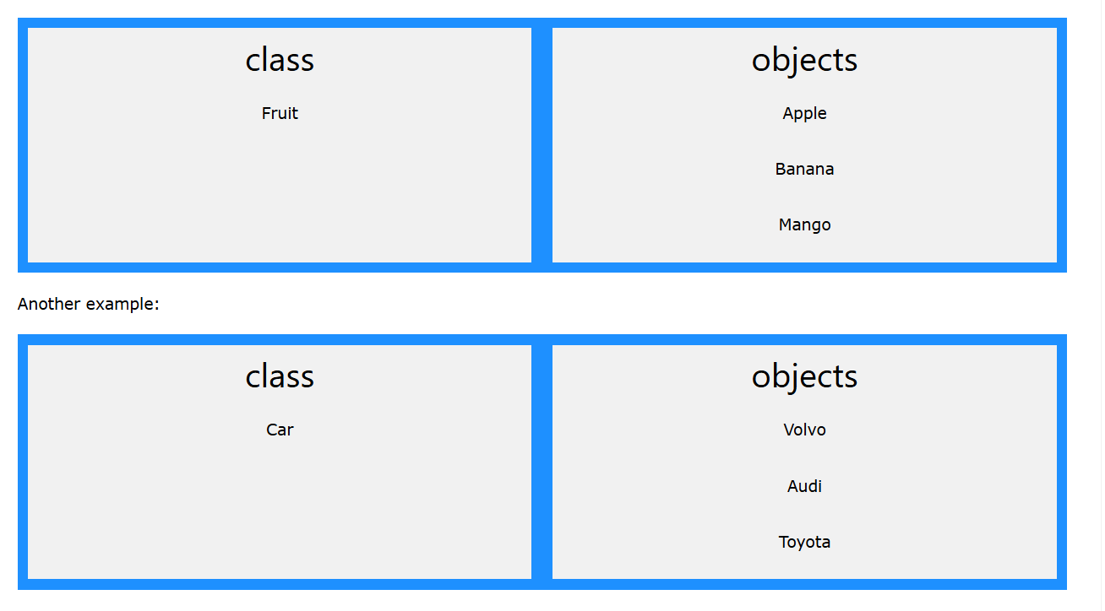
What is an Object?
A class is a blueprint for creating objects. It defines properties (variables) and methods (functions) that the object will have.
$myCar = new Car();
$myCar->drive(); // Outputs: Driving...

Slide 6
What is a Property?
A property is a variable defined inside a class. It holds data or state for an object.
class Car {
public $brand = "Toyota";
}

Slide 7
What is a Method?
A method is a function defined inside a class. It defines the behavior of the object.
class Car {
public function honk() {
echo "Beep!";
}
}

Slide 8
The 4 Main Principles of OOP in PHP
one of the most important sections in any OOP course is the 4 main principles of OOP, often called the "Pillars of OOP."

Slide 9
What is Encapsulation?
Definition:
Encapsulation is about hiding the internal details of how an object works and exposing only what is necessary.
Why it matters:
It protects data and helps keep your code clean and secure.

Slide 10
What is Abstraction?
Definition:
Abstraction means hiding complexity by showing only essential features of an object.
Why it matters:
Helps reduce complexity and makes your code easier to maintain.

Slide 11
What is Inheritance?
Definition:
Inheritance lets a class reuse properties and methods from another class. The new class is called a child, and the original is the parent.
Why it matters:
Avoids repeating code and promotes reuse.

Slide 12
What is Polymorphism?
Definition:
Polymorphism means many forms – the ability to use the same method name in different classes with different behavior.
Why it matters:
It lets you write flexible code that can work with different types of objects.

Slide 13
Thanks for sticking out till the end…keep learning

