Slide 1
Trend control historical Data _export data

Slide 2
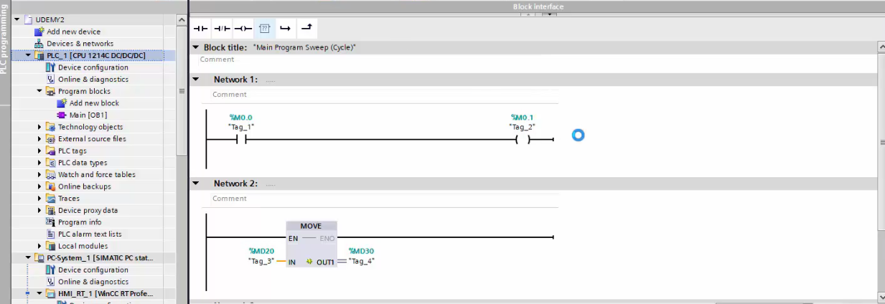
Step 1 : Create Simple ladder Programme Shown in Pic

Slide 3
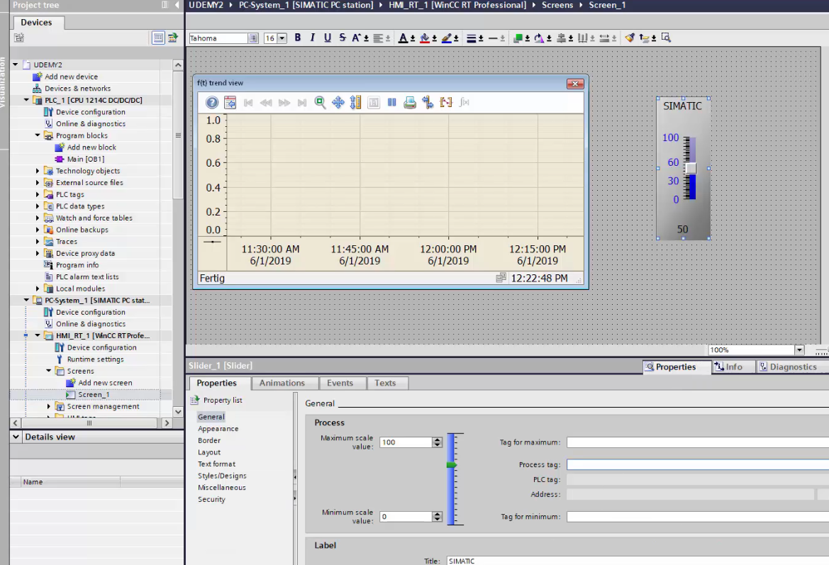
Step 2: Insert Trend and Slider

Slide 4
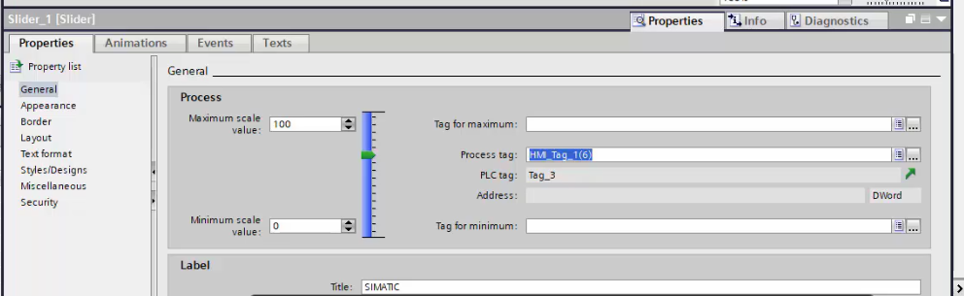
Step 3 : Connect PLC Tag with slider properties.

Slide 5
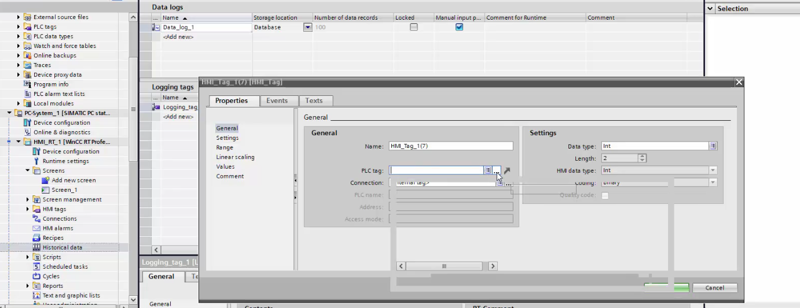
Step 4: Go to Historical Data and set data log and Logging tag detail

Slide 6
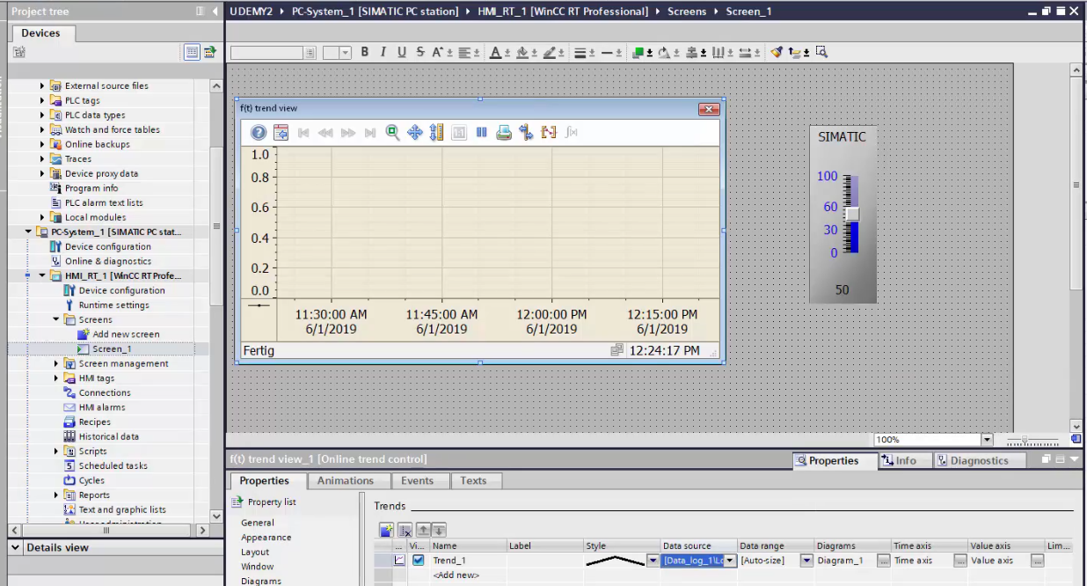
Step 6 : Interconnect Tends tag’s Data source with Historical Data tag

Slide 7
Thank - You

