Slide 1
OPC UA with WinCC

Slide 2
Kepserver EX
Classic OPC Comm
WinCC PRO
Classic OPC allows to access only the current data and is incapable to generate alarms, historical events whereas OPC UA supports features like historical events, multiple hierarchies and provides methods and programs (that are called commands).
We have already Seen this tutorial Before.
Not need Any Server Endpoint

Slide 3
OPC UA Server
OPC UA Client
Kepserver EX
OPC UA Comm
WinCC PRO
Transferring Data From Kepserver EX to WinCC PRO. In this Case Kepserver Act as Server and WinCC act As Client.
It works on Server endpoint
Opc.tcp:// machinename or IP’s :port name

Slide 4
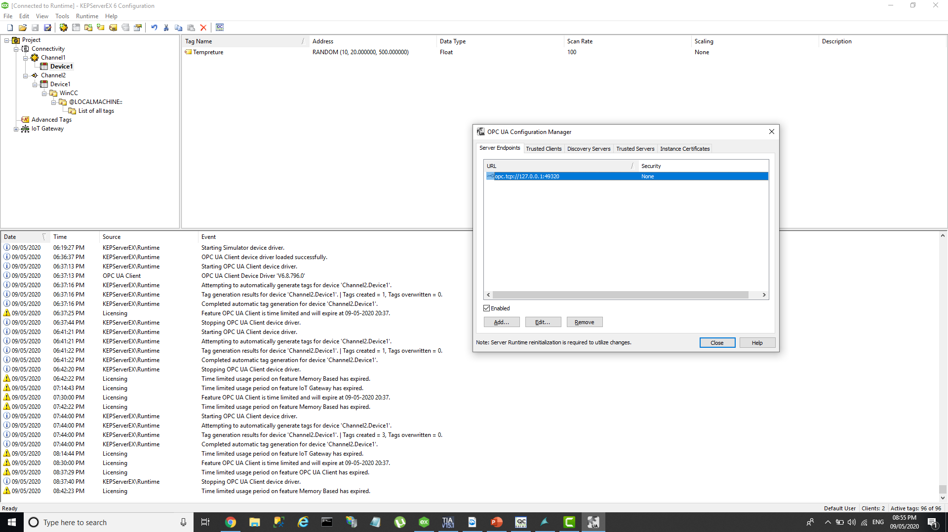
OPC UA Endpoint configuration with security Setting.

Slide 5
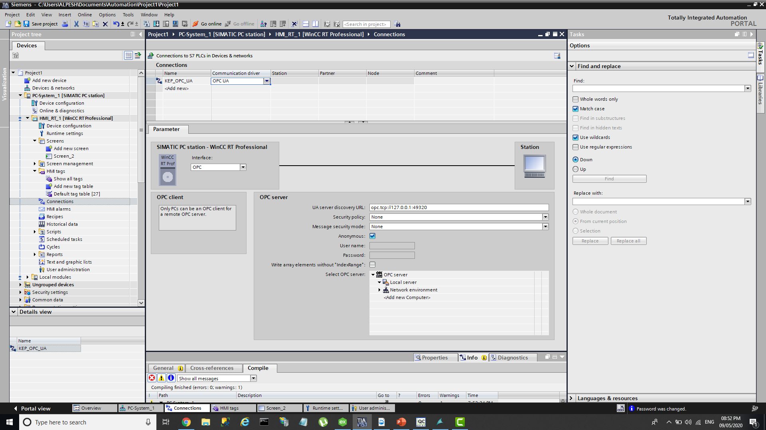
Kepserver OPC UA Server Endpoint Name

Slide 6
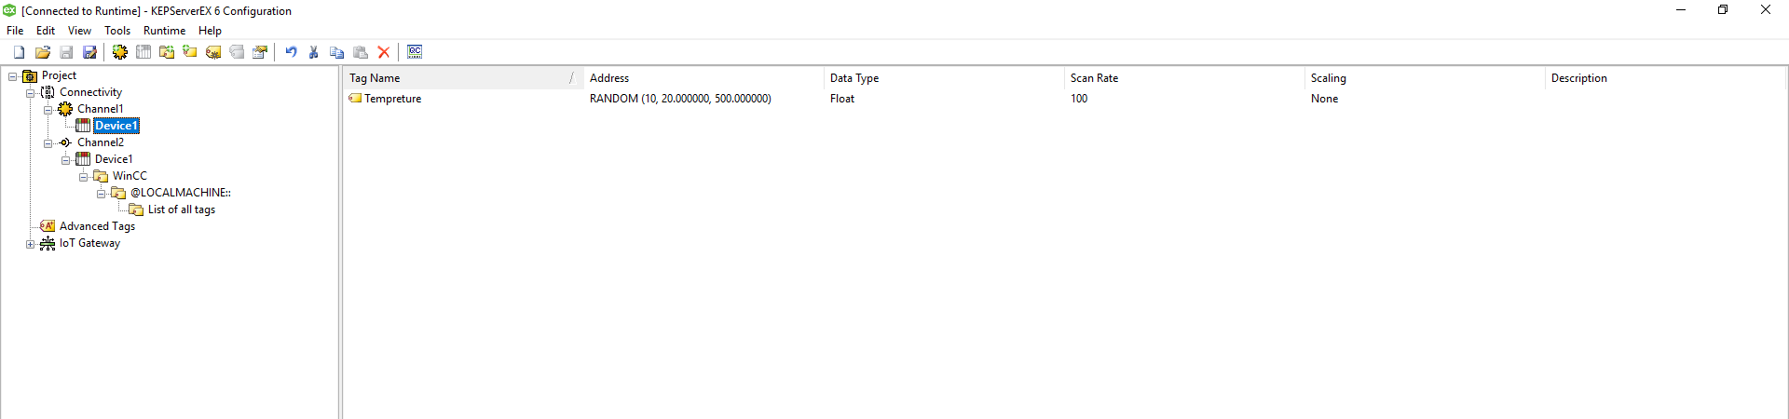
Create RANDOM Datatype TAG from Simulator Channel and Test IT.

Slide 7
OPC UA Client
OPC UA Server
Kepserver EX
OPC UA Comm
WinCC PRO
Transferring Data From Wincc PRO to Kepserver EX. In this Case Kepserver Act as Client and WinCC act As Server.
It works on Server endpoint
Opc.tcp:// machinename or IP’s :port name

Slide 8
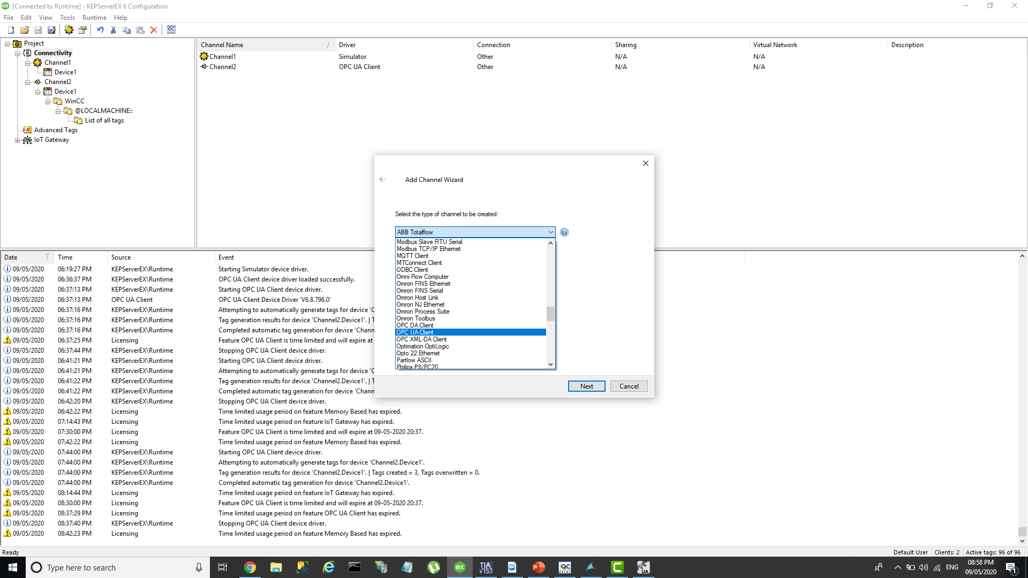
Create New Channel Using OPC UA Client

Slide 9
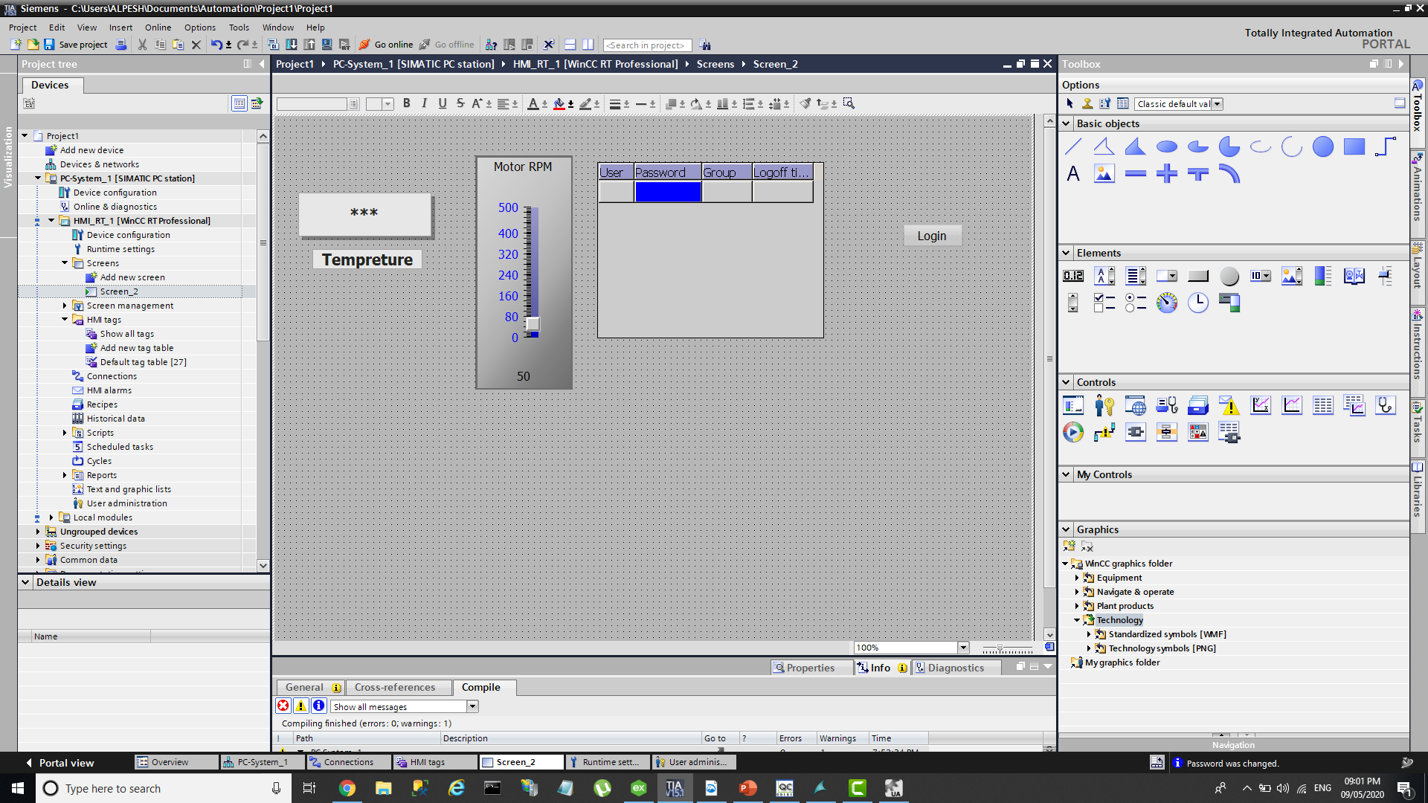
Create Screen , Add object ang Generate Internal TAG and System Tag Like User Login.

Slide 10
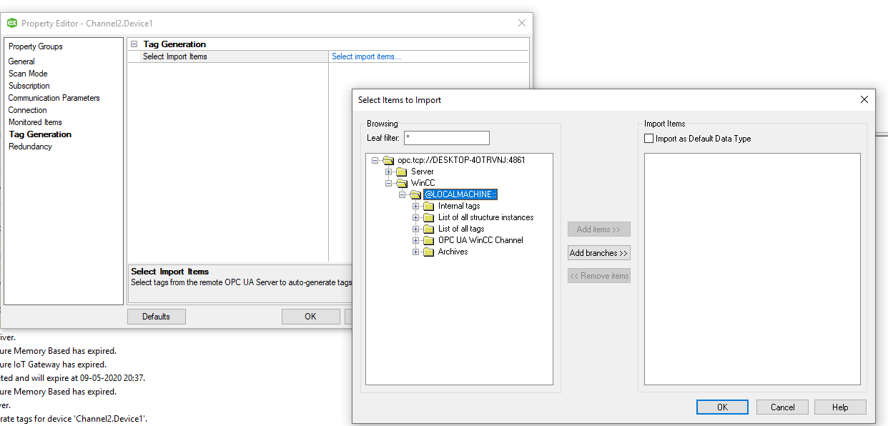
Add Device and Import TAG From Wincc Server.

Slide 11
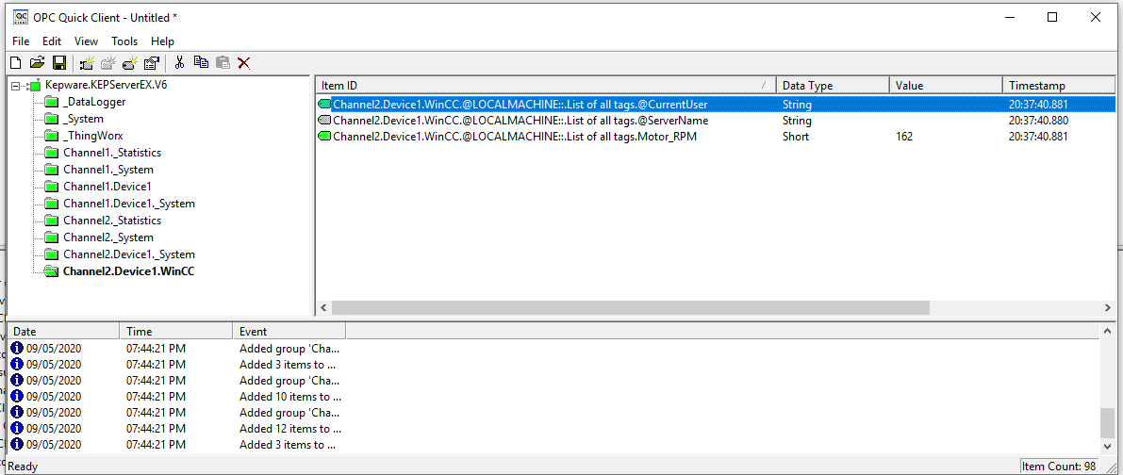
Test Imported TAG in OPC Quick Client.

